Slide 1
Encrypting Data in SQL Server
Steve Jones
Editor in Chief
SQLServerCentral

Slide 2
AGENDA
What is encryption?
Encryption in SQL Server
Communications
Transparent Data Encryption
Hashing
Keys
Symmetric Keys
Asymmetric Keys

Slide 3
BACK UP YOUR KEYS
Encryption is serious.
No help in recovering data from MS

Slide 4
AGENDA
What is encryption?
Encryption in SQL Server
Communications
Transparent Data Encryption
Hashing
Keys
Symmetric Keys
Asymmetric Keys

Slide 5
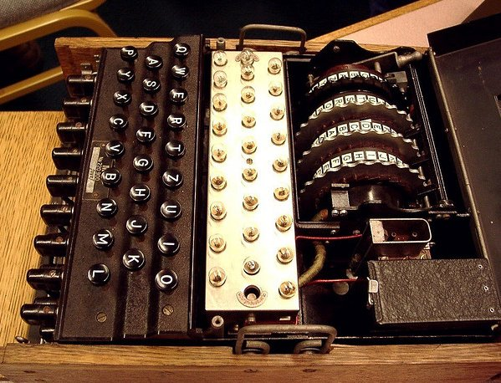
Notes:
What is encryption? The image is the Enigma Machine from WWII.

Slide 6
encryption is the process of transforming information (referred to as plaintext) using an algorithm (called a cipher) to make it unreadable to anyone except those possessing special knowledge, usually referred to as a key. The result of the process is encrypted information (in cryptography, referred to as ciphertext).
- Wikipedia
Notes:
From Wikipedia

Slide 7
SIMPLE CIPHERS
ABCDEFGHIJKLMNOPQRSTUVWXYZ
DEFGHIJKLMNOPQRSTUVWXYZABC
WKLV LV HQFUBSWHG
Notes:
A simple cipher, known as a substitution or rotation cipher. In this case, this is a ROT4. The bottom line is an encrypted string. The top line is the plain text line, and the second line is used to encrypt or decrypt the data.

Slide 8
SIMPLE CIPHERS
ABCDEFGHIJKLMNOPQRSTUVWXYZ
DEFGHIJKLMNOPQRSTUVWXYZABC
WKLV LV HQFUBSWHG
THIS IS ENCRYPTED
Notes:
And the decryption

Slide 9
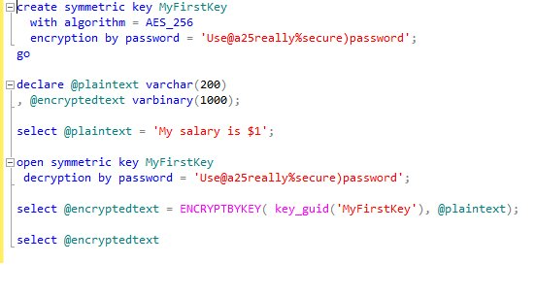
Results:
-------------------------------------------
0x00E2A26D824E22468392458DE6F450DA0100000025DE09EF3AD8D7C989E393BF9FE1368D04C1B9BEE086EFFDF6F77AF9E3A3B8142F23723D536C72C216D6F9B104A5E44A
Notes:
Here is a more complex encryption using a symmetric key in T-SQL.

Slide 10
AGENDA
What is encryption?
Encryption in SQL Server
Communications
Transparent Data Encryption
Hashing
Keys
Symmetric Keys
Asymmetric Keys

Slide 11





SQL Server Instance
Communication Link
(the wire)
Client
SQL Server memory
Client file system
Backup files
SQL Server data files
Notes:
Here is the essential link between a client and server. The client has a computer, with a file system and connect to the SQL Server instance across some communication link (the wire). The data in SQL Server is available in its memory (for querying, manipulating, etc.). The data gets stored on disk drives in the data files, and then is copied to backup files, either on disk or tape.

Slide 12
SQL Server Instance
Communication Link
(the wire)
Client
SQL Server memory
Client file system
Backup files
SQL Server data files
Notes:
We can’t do much about the client file system. If clients copy/paste data into a text file, spreadsheet, etc., we lose control. Even if they take an image of the screen, they can store data unprotected on their local file system

Slide 13
SQL Server Instance
Communication Link
(the wire)
Client
SQL Server memory
SL Server memory
Client file system
Backup files
SQL Server data files
Notes:
We can’t do a lot to encrypt things on the client as that’s where we really need data decrypted so the client can read it.

Slide 14
SQL Server Instance
Communication Link
(the wire)
Client
SQL Server memory
Client file system
Backup files
SQL Server data files
Notes:
We can encrypt the wire, using SSL communication in SQL Server, or some higher level tunneling like IPSec.

Slide 15
SQL Server Instance
Communication Link
(the wire)
Client
SQL Server memory
Client file system
Backup files
SQL Server data files
Notes:
We can encrypt data in SQL Server’s memory. Not completely, but we can use one of our encryption methods to ensure that queries require keys to return the plaintext.

Slide 16
SQL Server Instance
Communication Link
(the wire)
Client
SQL Server memory
Client file system
Backup files
SQL Server data files
Notes:
If we use keys, we also have encryption of the data on the data files, or we have the option of using Transparent Data Encryption

Slide 17
SQL Server Instance
Communication Link
(the wire)
Client
SQL Server memory
Client file system
Backup files
SQL Server data files
Notes:
As with the data files, we can encrypt the backup files as well.

Slide 18
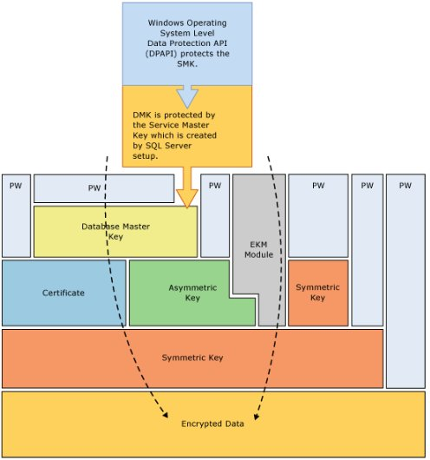

Slide 19
AGENDA
What is encryption?
Encryption in SQL Server
Communications
Transparent Data Encryption
Hashing
Keys
Symmetric Keys
Asymmetric Keys

Slide 20
COMMUNICATIONS
Encrypt the connection to/from SQL Server
  Encrypt “the wire”
Two options
  SSL encryption from SQL Server
  IPSec encryption at the Windows host network layer.

Slide 21
SSL COMMUNICATIONS
Install certificate on Windows
In Configuration Manager, set the FORCE ENCRYPTION options for each protocol
Certificate must be valid based on the system time
DO NOT USE SELF SIGNED CERTIFICATES
All rules in BOL
  Encrypting Connections to SQL Server
  How to: Enable Encrypted Connections to the Database Engine

Slide 22
DEMO
Set encryption options for communications.

Slide 23
AGENDA
What is encryption?
Encryption in SQL Server
Communications
Transparent Data Encryption
Hashing
Keys
Symmetric Keys
Asymmetric Keys

Slide 24
TRANSPARENT DATA ENCRYPTION
TDE introduced in SQL Server 2008
Protects the data at rest by encrypting the data on disk.
  Data files and transaction log files are encrypted
  Backups are encrypted (can eliminate compression)
  Tempdb is encrypted for all operations.
  Replication data is not encrypted
  Filestream data is not encrypted

Slide 25
TRANSPARENT DATA ENCRYPTION
Encryption is handled by the Database Encryption Key (DEK)
Requires a Database Master Key (DMK) and a Certificate to protect the DEK
Backups of the certificate protecting the DEK are necessary to restore a backup.

Slide 26
DEMO
TDE enable, backup, and restore demo
Notes:
Create unencrypted db. Detach. View with hex editor. Encrypt, detach, view.

Slide 27
TRANSPARENT DATA ENCRYPTION
Overhead is < 5%
Enterprise Edition only (not BI edition)
Value?
Third Party Tools

Slide 28
BACK UP YOUR KEYS

Slide 29
AGENDA
What is encryption?
Encryption in SQL Server
Communications
Transparent Data Encryption
Hashing
Keys
Symmetric Keys
Asymmetric Keys

Slide 30
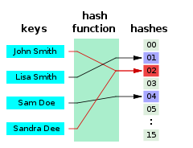
HASHING
“A hash function is any algorithm or subroutine that maps large data sets, called keys, to smaller data sets.” - Wikipedia

Slide 31
HASHING
SQL Server uses the HASHBYTES functions
CHECKSUM() or BINARY_CHECKSUM() can also be used, but not for encryption
other implementations using .NET/CLR are better. (see Expert SQL Server Encryption, Michael Coles)
SQL Server 2012 adds SHA2_256 and SHA2_512 algorithms.

Slide 32
DEMO
Hashing functions and usage.

Slide 33
HASHING OR ENCRYPTION
Hashing is not really encryption
  Decryption is not supported (usually)
Hashing is deterministic, encryption is not
Hashing is quicker
In general, a hash of searchable data can be used to allow indexing of encrypted data.
Choose the strongest algorithm available in your version.
  SQL Server 2008 – SHA1
  SQL Server 2012 - SHA2_512
Consider using your own algorithm with SQLCLR
  Don’t invent your algorithm. Use a well known one (SHA3)

Slide 34
AGENDA
What is encryption?
Encryption in SQL Server
Communications
Transparent Data Encryption
Hashing
Keys
Symmetric Keys
Asymmetric Keys

Slide 35
KEYS
Service Master Key
Database Master Key
Database Encryption Key
Symmetric Keys
Asymmetric Keys
Certificates

Slide 36
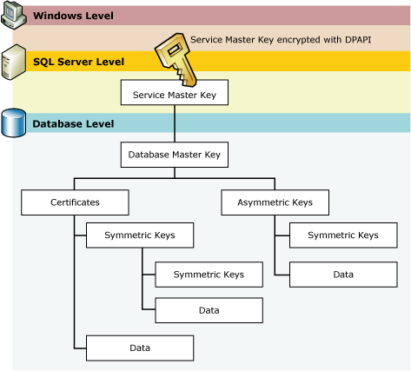

Slide 37
BACK UP YOUR KEYS

Slide 38
SERVICE MASTER KEY
Service Master Key = SMK
The Service Master Key is created when it is first needed. No CREATE DDL
Secured by Windows DPAPI (default)
AES encryption
Accessed by Service Account for database engine, or a principal with access to the service account name and password

Slide 39
DATABASE MASTER KEY
Database Master Key = DMK
Per database (not just master)
The Database Master Key is created by an administrator (CREATE/ALTER DDL)
This is secured by the SMK and a password (TripleDES encryption in 2008, AES in 2012)
This can be secured by password only (DROP ENCRYPTION BY SERVICE MASTER KEY option)

Slide 40
DATABASE MASTER KEY
Backup and restore using DDL commands
BACKUP MASTER KEY
RESTORE MASTER KEY
OPEN/CLOSE manually if not protected by the SMK
Attach/restore of an encrypted database requires the password for the DMK
You can alter the DMK to add/remove SMK encryption after attach/restore

Slide 41
AGENDA
What is encryption?
Encryption in SQL Server
Communications
Transparent Data Encryption
Hashing
Keys
Symmetric Keys
Asymmetric Keys

Slide 42
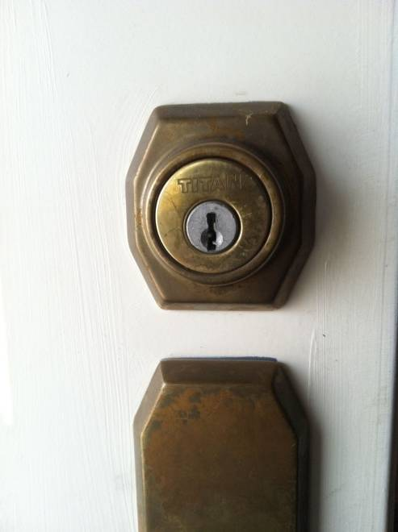
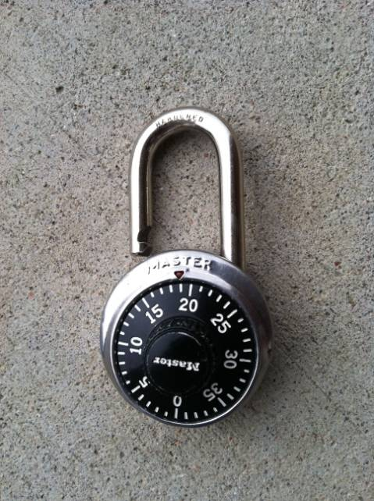
SYMMETRIC ENCRYPTION
Like a normal key lock
The key that encrypts the data also decrypts the data

Slide 43
SYMMETRIC KEYS
Symmetric Keys are created in a database and are always in that database (cannot be backed up/restored)
Symmetric Keys are deterministic, and can be duplicated with the same creation parameters.
Symmetric keys require less resources than asymmetric keys, but more than hashing.
You can, and should, secure these keys with asymmetric keys

Slide 44
DEMO
Symmetric Keys

Slide 45
SYMMETRIC KEYS
The algorithm used is stored in the header of the encrypted data.
You can generate temporary keys for encryption/decryption
  CREATE SYMMETRIC KEY #MyTempKey
You can perform symmetric encryption with passphrases (TripleDES)

Slide 46
AGENDA
What is encryption?
Encryption in SQL Server
Communications
Transparent Data Encryption
Hashing
Keys
Symmetric Keys
Asymmetric Keys

Slide 47
ASYMMETRIC ENCRYPTION
Asymmetric keys are unlike keys and locks in the real world.
Based on factoring very large prime numbers.
More secure than symmetric keys
Require more resources for encryption/decryption than symmetric keys

Slide 48

Key 1
0x26CD66B61E50369CBBDB42F484237370E02238EEAE588E06D00F8D0C6FAB5C48F68639ABB4003564CFB48A41BA373CFA411E99D3AB31A1B7CE40CB35
Now is the time for all good men to come to the aid of their country
Asymmetric Algorithm
Key 1
0x26CD66B61E50369CBBDB42F484237370E02238EEAE588E06D00F8D0C6FAB5C48F68639ABB4003564CFB48A41BA373CFA411E99D3AB31A1B7CE40CB35
0xE7A518047A8D3836B76006D9CE04DA2F803607A57CD7F9EE855FC3451EB02A076F28DD614BA841AC756E52CFEC4006746480C8204D579083C4AD0D627CAD24
Asymmetric Algorithm

Slide 49
Key 1
0x26CD66B61E50369CBBDB42F484237370E02238EEAE588E06D00F8D0C6FAB5C48F68639ABB4003564CFB48A41BA373CFA411E99D3AB31A1B7CE40CB35
Now is the time for all good men to come to the aid of their country
Asymmetric Algorithm
Key 2
0x26CD66B61E50369CBBDB42F484237370E02238EEAE588E06D00F8D0C6FAB5C48F68639ABB4003564CFB48A41BA373CFA411E99D3AB31A1B7CE40CB35
Now is the time for all good men to come to the aid of their country
Asymmetric Algorithm

Slide 50


Key 1 – Private Key
Key 2 – Public Key
Keys 1 and 2 are paired and generated together.
One is referred to as a private key and the other a public key. Only the user has the private key, but the public key is distributed to everyone

Slide 51
Anyone encrypts with Steve’s Public Key
0x26CD66B61E50369CBBDB42F484237370E02238EEAE588E06D00F8D0C6FAB5C48F68639ABB4003564CFB48A41BA373CFA411E99D3AB31A1B7CE40CB35
Now is the time for all good men to come to the aid of their country
Asymmetric Algorithm
0x26CD66B61E50369CBBDB42F484237370E02238EEAE588E06D00F8D0C6FAB5C48F68639ABB4003564CFB48A41BA373CFA411E99D3AB31A1B7CE40CB35
Only Steve can decrypt with his private key
Now is the time for all good men to come to the aid of their country
Asymmetric Algorithm

Slide 52
Steve can encrypt with his private key
0x26CD66B61E50369CBBDB42F484237370E02238EEAE588E06D00F8D0C6FAB5C48F68639ABB4003564CFB48A41BA373CFA411E99D3AB31A1B7CE40CB35
Now is the time for all good men to come to the aid of their country
Asymmetric Algorithm
0x26CD66B61E50369CBBDB42F484237370E02238EEAE588E06D00F8D0C6FAB5C48F68639ABB4003564CFB48A41BA373CFA411E99D3AB31A1B7CE40CB35
Anyone can decrypt with Steve’s public key
Now is the time for all good men to come to the aid of their country
Asymmetric Algorithm

Slide 53
Steve can encrypt with his private key
0x26CD66B61E50369CBBDB42F48423737
Now is the time
Steve encrypts again with Andy’s Public Key
0x26CD66B61E50369CBBDB42F48423737
0x48385D8A87BD329FF328E476BC234

Slide 54
Andy decrypts the outer message with his private key
0x48385D8A87BD329FF328E476BC234
0x26CD66B61E50369CBBDB42F48423737
Andy then decrypts with Steve’s Public key to verify the message is from Steve
0x26CD66B61E50369CBBDB42F48423737
Now is the time

Slide 55
ASYMMETRIC ENCRYPTION
Use DDL to create asymmetric keys (CREATE/DROP/ALTER)
Can be created outside the server (FROM FILE option)
  SN.exe (Visual Studio SDK)
  Makecert (Windows SDK)
These keys work the same as symmetric keys, except
You can back them up

Slide 56
ASYMMETRIC ENCRYPTION
You can encrypt an asymmetric key with a password.
  This will be required for decryption
  Not required for encryption
Asymmetric keys are usually used to encrypt symmetric keys, which encrypt the data. This balances security with resources
You can remove the private key (prevents decryption in that db).

Slide 57
CERTIFICATES
Certificates are asymmetric keys with additional metadata.
Expiration dates are not enforced by SQL Server
  Administrators must decrypt/re-encrypt the data and remove the old certificates
  Useful for marking the key rotation dates (query sys.certificates)
To restore certificates, use CREATE CERTIFICATE.
SQL Server 2012 increases the maximum certificate length to 4,096.
Always use the longest length you can.

Slide 58
DEMO
Asymmetric Keys

Slide 59
KEY LENGTH
Use long keys
Use strong algorithms (MD5/SHA1 = bad)
DKIM attack on Google’s mail system*
  384 bit key cracked on high end laptop
  512 bit key cracked for ~$75 using AWS
  768 bit key could be cracked by large orgs
  This changes all the time
  www.wired.com/threatlevel/2012/10/dkim-vulnerability-widespread/all/

Slide 60
BACK UP YOUR KEYS

Slide 61
THE END
Questions?
Don’t forget to fill out your evaluations
Resources at the end of the PPT
www.sqlservercentral.com/forums
www.voiceofthedba.com/talks

Slide 62
REFERENCES
Encryption - http://en.wikipedia.org/wiki/Encryption
Understanding TDE - http://msdn.microsoft.com/en-us/library/bb934049.aspx
Hash Function - http://en.wikipedia.org/wiki/Hash_function
Rainbow Tables - http://en.wikipedia.org/wiki/Rainbow_table
Transparent Data Encryption – https://www.simple-talk.com/sql/database-administration/transparent-data-encryption/
How to enable/remove Transparent Data Encryption (TDE) - http://blogs.msdn.com/b/batuhanyildiz/archive/2012/10/16/how-to-enable-remove-transparent-data-encryption-tde.aspx
Sys.database_encryption_keys - http://msdn.microsoft.com/en-us/library/bb677274.aspx
TDE and Backup Compression - http://sqlcat.com/sqlcat/b/technicalnotes/archive/2009/02/16/tuning-backup-compression-part-2.aspx
Encrypting Connections to SQL Server - http://msdn.microsoft.com/en-us/library/ms189067.aspx
ENCRYPTBYCERT - http://technet.microsoft.com/en-us/library/ms188061.aspx
DECRYPTBYKEY - http://technet.microsoft.com/en-us/library/ms181860.aspx
DECRYPTBYASYMKEY - http://technet.microsoft.com/en-us/library/ms189507.aspx
DECRYPTBYCERT - http://technet.microsoft.com/en-us/library/ms178601.aspx
DECRYPTBYKEYAUTOASYMKEY - http://technet.microsoft.com/en-us/library/ms365420.aspx
DECRYPTBYKEYAUTOCERT - http://technet.microsoft.com/en-us/library/ms182559.aspx

Slide 63
REFERENCES
HASHBYTES - http://msdn.microsoft.com/en-us/library/ms174415.aspx
CHECKSUM() - http://msdn.microsoft.com/en-us/library/ms189788.aspx
BINARY_CHECKSUM() - http://msdn.microsoft.com/en-us/library/ms173784.aspx
Expert SQL Server Encryption - http://www.amazon.com/gp/product/1430224649?ie=UTF8&amp;tag=redgatsof-20&amp;linkCode=as2&amp;camp=1789&amp;creative=9325&amp;creativeASIN=1430224649
Data Hashing in SQL Server - http://blogs.msdn.com/b/sqlsecurity/archive/2011/08/26/data-hashing.aspx
CREATE ASYMMETRIC KEY - http://technet.microsoft.com/en-us/library/ms174430.aspx
ALTER ASYMMETRIC KEY - http://technet.microsoft.com/en-us/library/ms187311.aspx
CREATE CERTIFICATE - http://technet.microsoft.com/en-us/library/ms187798.aspx
ALTER CERTIFICATE - http://technet.microsoft.com/en-us/library/ms189511.aspx
BACKUP CERTIFICATE - http://technet.microsoft.com/en-us/library/ms178578.aspx
sys.certificates - http://technet.microsoft.com/en-us/library/ms189774.aspx
ENCRYPTBYPASSPHRASE - http://technet.microsoft.com/en-us/library/ms188910.aspx
ENCRYPTBYKEY - http://technet.microsoft.com/en-us/library/ms174361.aspx
ENCRYPTBYASYMKEY - http://technet.microsoft.com/en-us/library/ms186950.aspx

Slide 64
REFERENCES
http://blogs.msdn.com/b/raulga/archive/2006/03/11/549754.aspx
Windows SDK (Makecert) - http://msdn.microsoft.com/en-us/windowsserver/bb980924.aspx
SN.EXE - http://msdn.microsoft.com/en-us/library/k5b5tt23.aspx
Subway Hacked - http://arstechnica.com/business/news/2011/12/how-hackers-gave-subway-a-30-million-lesson-in-point-of-sale-security.ars
Install SSL Certificate - http://blogs.msdn.com/b/jorgepc/archive/2008/02/19/enabling-certificates-for-ssl-connection-on-sql-server-2005-clustered-installation.aspx
Encrypting Connections to SQL Server - http://msdn.microsoft.com/en-us/library/ms189067.aspx
SQL Server 2005: A look at the master keys - part 2 - http://blogs.msdn.com/b/lcris/archive/2005/09/30/475822.aspx
Cryptography in SQL Server http://msdn.microsoft.com/en-us/library/cc837966%28v=sql.100%29.aspx
http://arstechnica.com/security/2013/05/how-crackers-make-minced-meat-out-of-your-passwords/

Slide 65
IMAGES
Enigma Machine - http://www.flickr.com/photos/badwsky/34164244/
The Encryption Hierarchy from BOL - http://msdn.microsoft.com/en-US/library/ms189586%28v=SQL.90%29.aspx
Hashing Image - http://upload.wikimedia.org/wikipedia/commons/thumb/5/58/Hash_table_4_1_1_0_0_1_0_LL.svg/240px-Hash_table_4_1_1_0_0_1_0_LL.svg.png
TDE Structure - http://msdn.microsoft.com/en-us/library/bb934049.aspx

